Slide 1
Scientific Machine Learning for Modeling, Optimization, and Control of Dynamical Systems
Ján Drgoňa
Associate Professor Civil and Systems Engineering Department The Ralph O'Connor Sustainable Energy Institute (ROSEI)
Data Science and AI Institute (DSAI)

Slide 2
Course Syllabus
Week 1: Introduction to Scientific Machine Learning (SciML)
Week 2: Introduction to differentiable programming
Week 3: Physics-informed neural networks (PINNs)
Week 4: Neural ordinary differential equations (NODEs)
Week 5: Neural differential equations with constraints
Week 6: Learning to optimize (L2O)
Week 7: Feasibility restoration methods in L2O
Week 8: Differentiable control
Week 9: Safety filters for learning-based control
Week 10: SciML applications
Week 11: Project evaluation with presentations

Slide 3
Prerequisites
Differential calculus
Linear algebra
Solid Python programming skills
Deep learning fundamentals
Constrained optimization fundamentals
Dynamical systems fundamentals
Optimal control fundamentals

Slide 4
Grading
Homework 30% Weeks 2,3,4
Project proposal 20% Week 5
Project progress report 10% Week 8
Project final report 20% Week 11
Project presentation 20% Weel 12

Slide 5
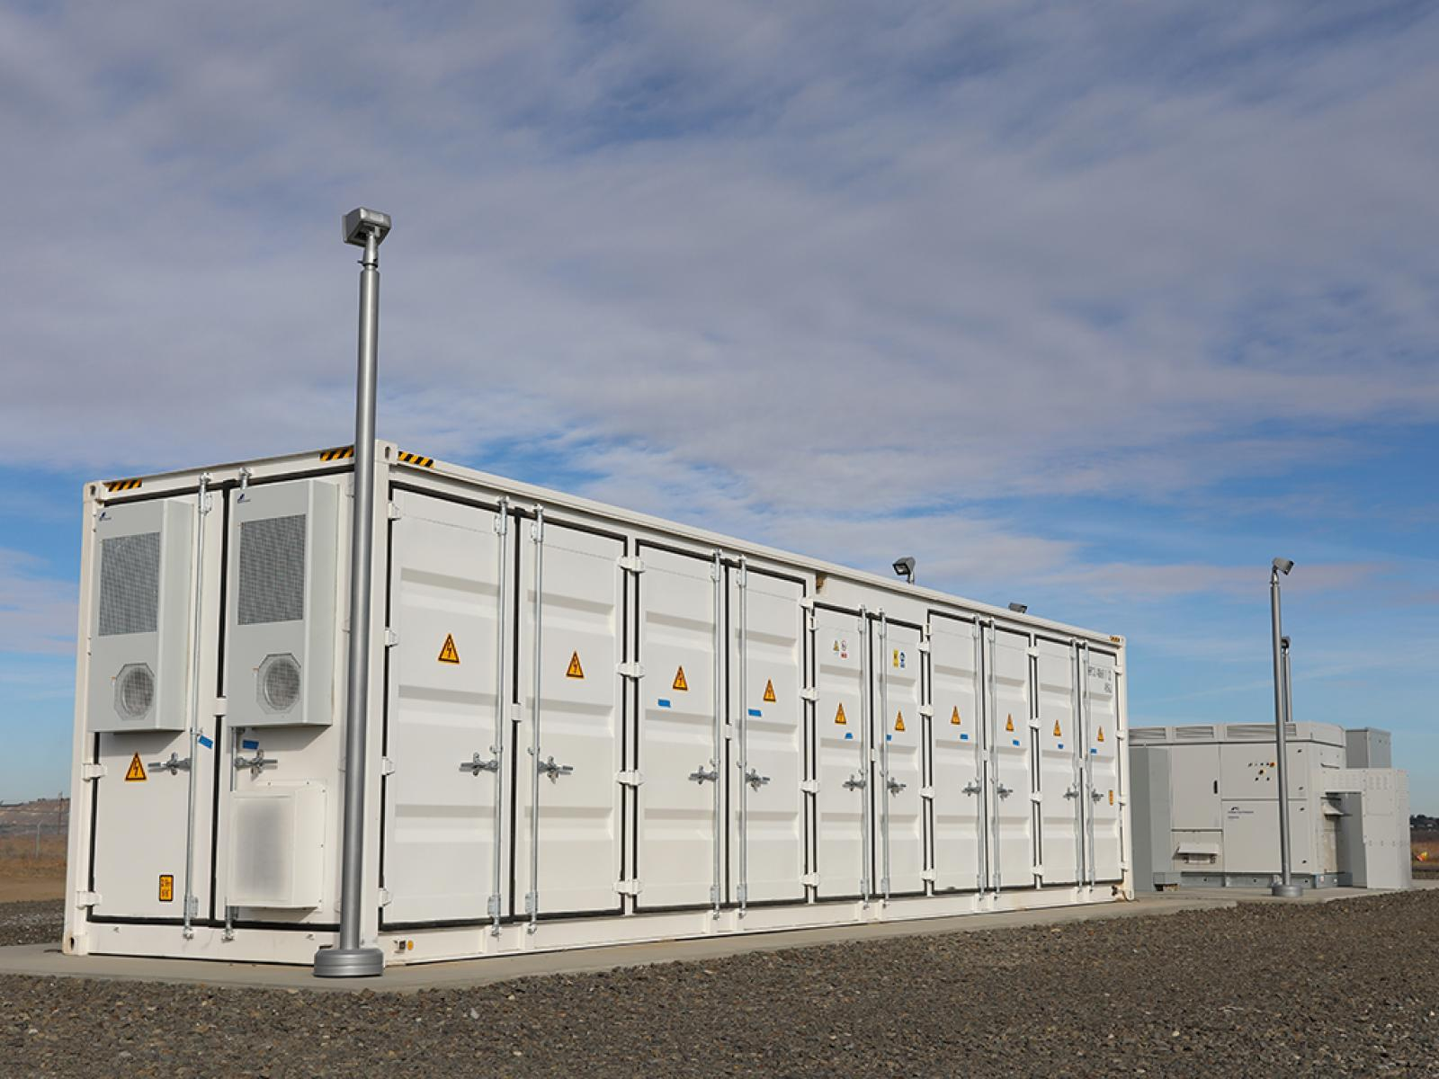

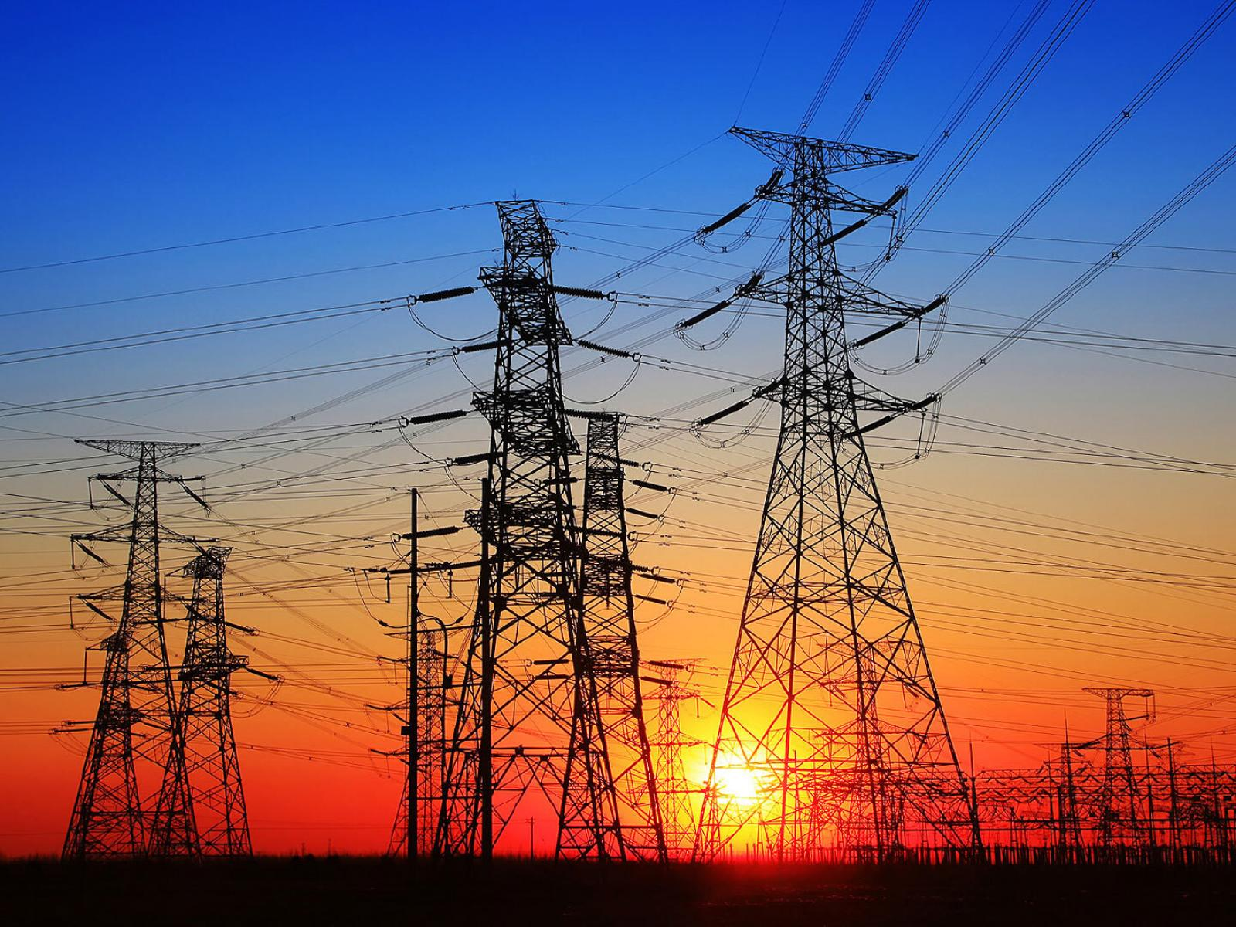

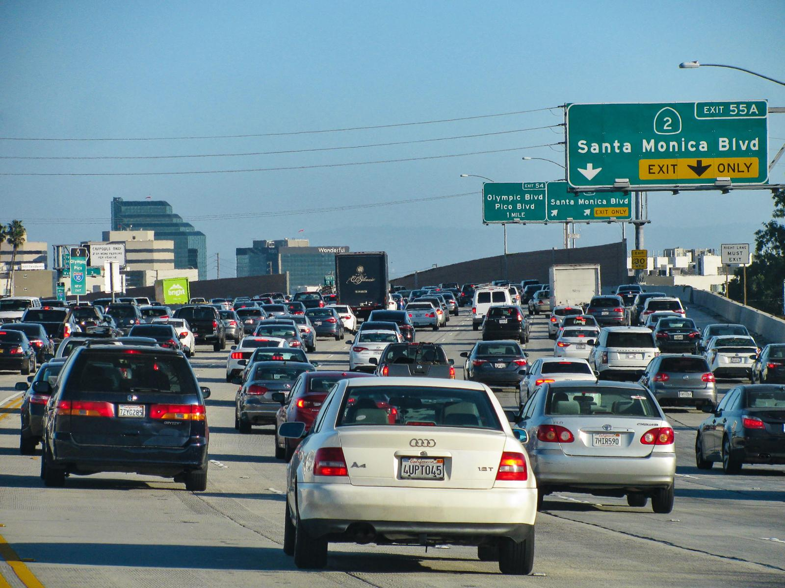
Optimizing Complex Systems is Hard
Simulations are crucial for optimal decision-making in complex energy systems
Need: Improve computational efficiency and scalability of digital twins and optimization-based decision-making
Challenges:
Modeling and simulation of complex systems is hard
Closed-loop decision-making for complex systems is hard-er
Scientific computing and machine learning tools are fragmented and not easily composable

Slide 6
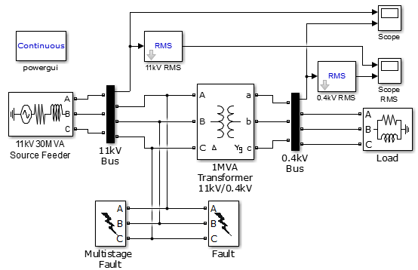
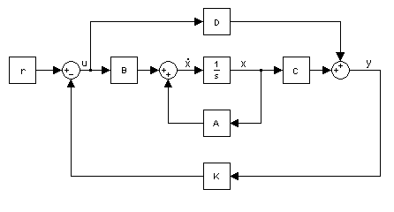

Challenge 1: Heterogenous Modeling Methods
White-box models
Gray-box models
Black-box models
Physics-based
Data-driven
More domain knowledge
Less domain knowledge

Slide 7

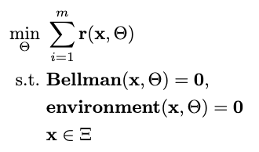

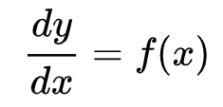

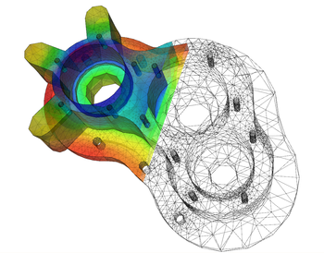
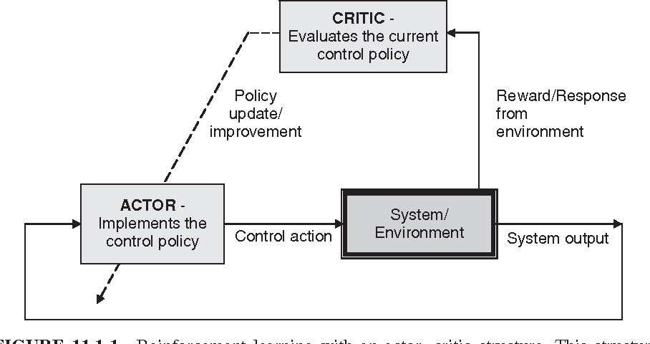

Challenge 2: Heterogenous Solution Methods
Constrained Optimization
Differential Equations
Supervised Learning
Reinforcement Learning
Requires prior knowledge of objective function and constraints
Requires prior knowledge of the physics to be modeled
Requires large labeled datasets
Requires environment model to sample
More domain knowledge
Less domain knowledge

Slide 8
















Challenge 3: Heterogenous Solution Tools
Constrained Optimization
Differential Equations
Supervised Learning
Reinforcement Learning
More domain knowledge
Less domain knowledge

Slide 9
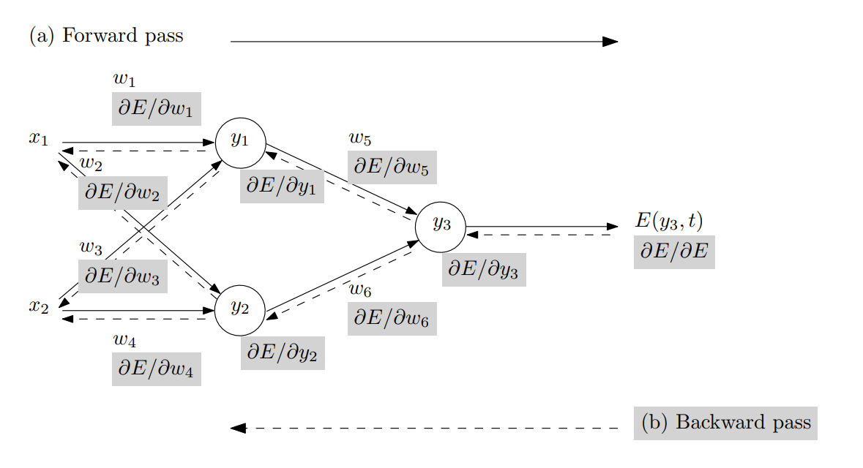
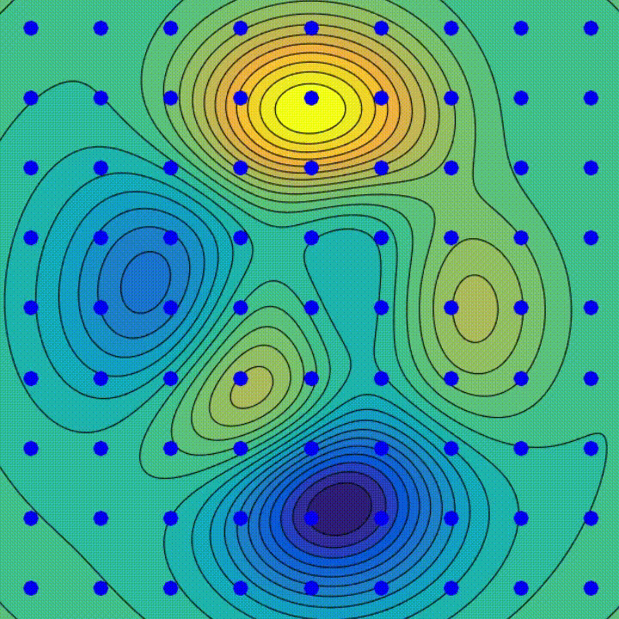
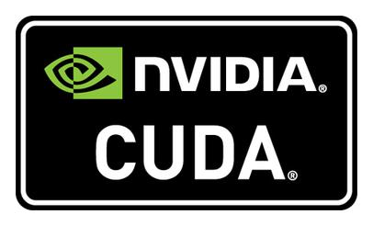

Automatic Differentiation (AD) in Machine Learning
AD enables efficient and accurate gradient computation, which is fundamental for training complex ML models using GPUs.
Backpropagation Algorithm
Gradient Descent Algorithm
SW and HW Innovations
Animation source: wikipedia
Baydin, Atilim Gunes et al. Automatic differentiation in machine learning: a survey. Journal of Machine Learning Research, 2015

Slide 10
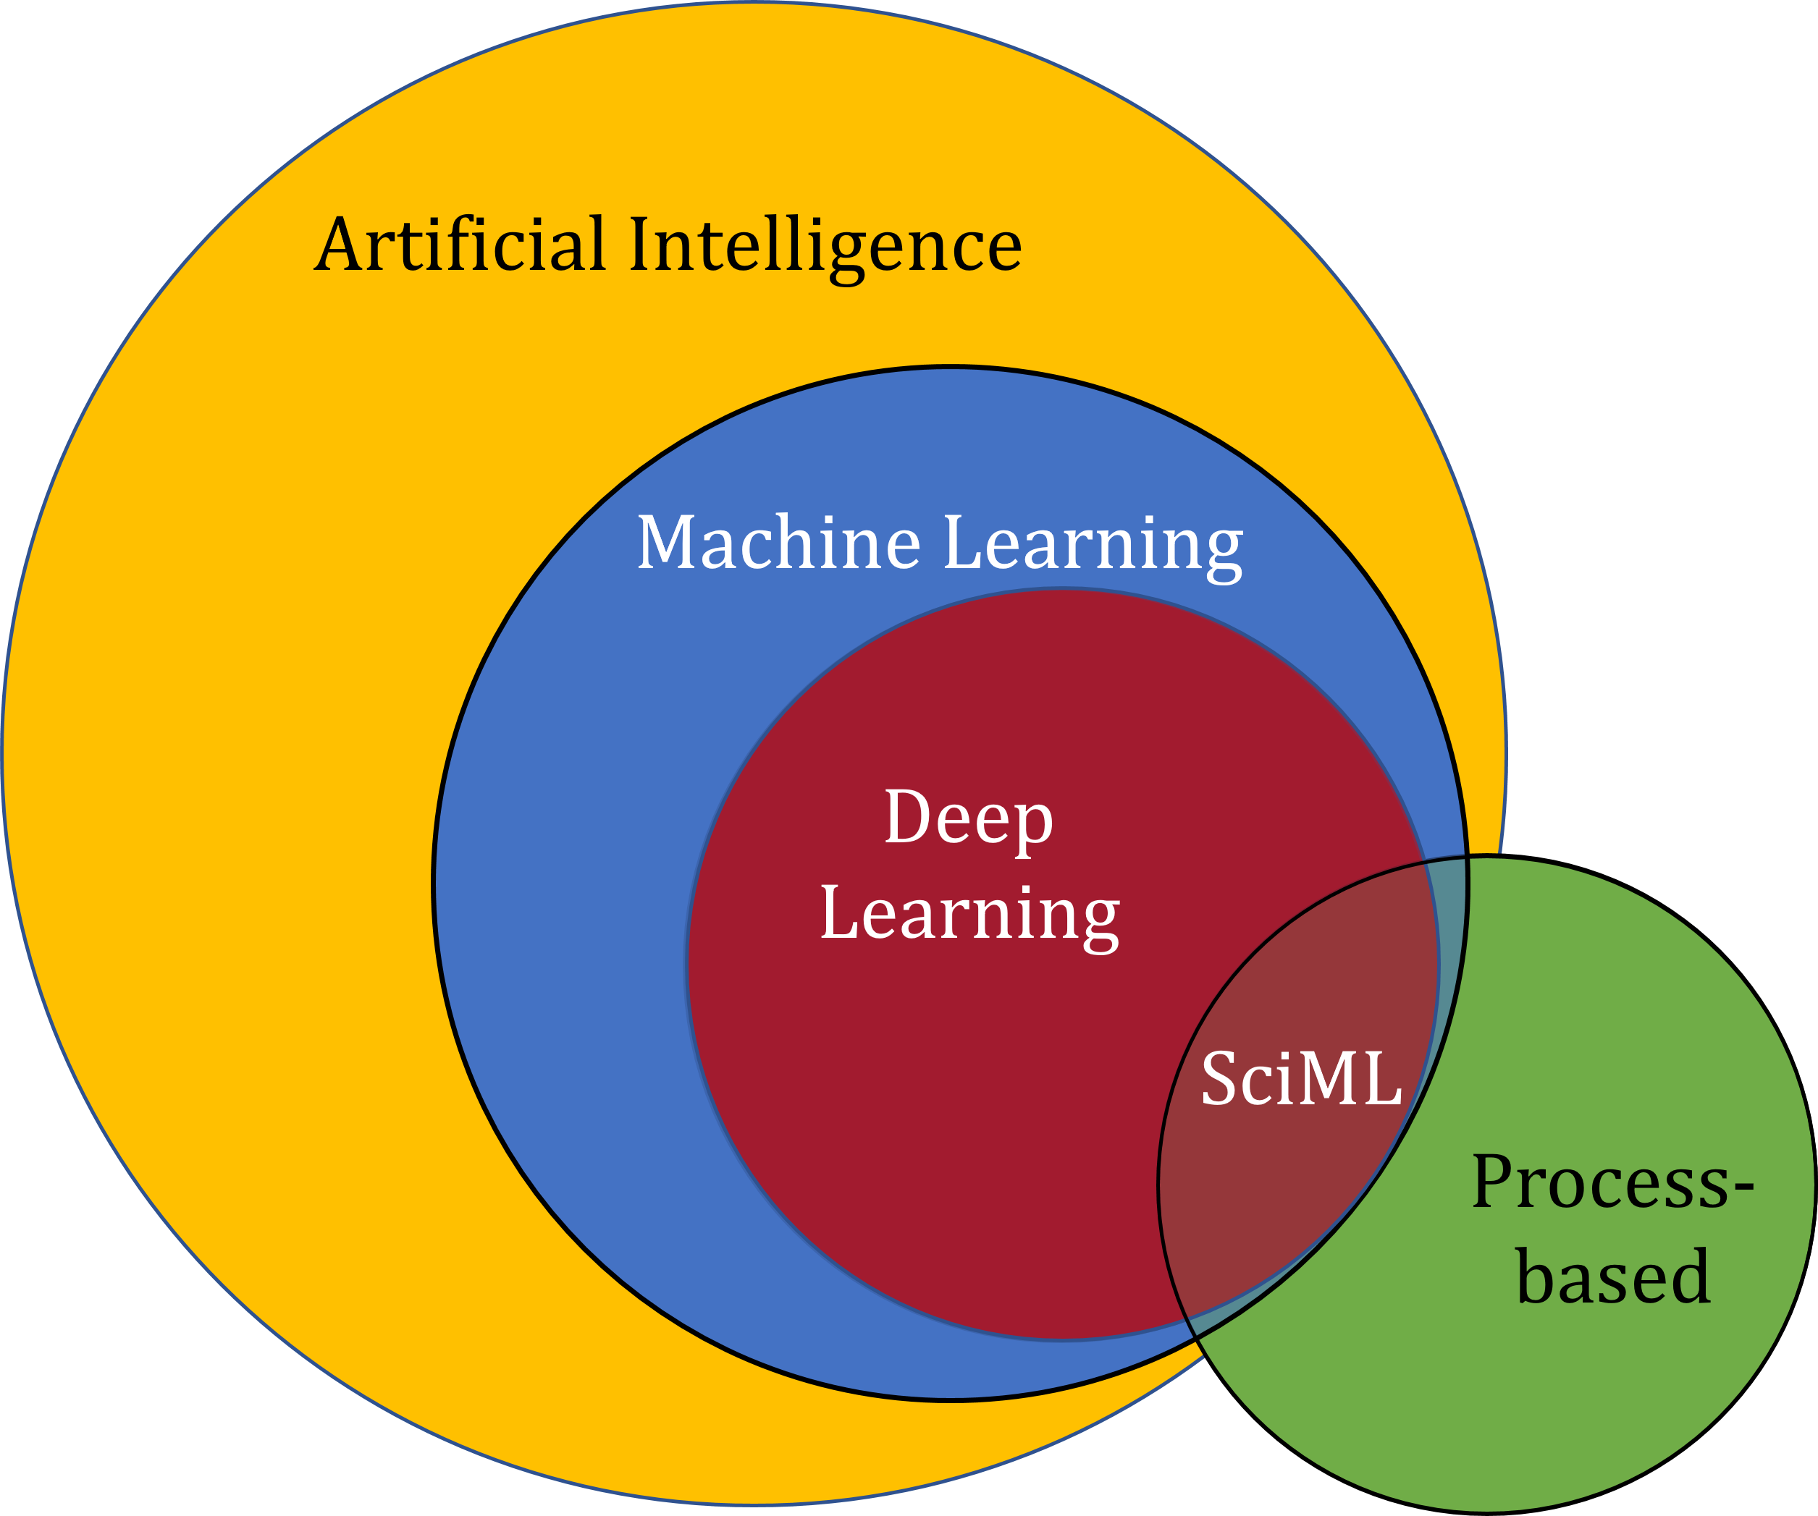
Scientific Machine Learning (SciML)
What?
SciML systematically integrates ML methods with mathematical models and algorithms developed in various scientific and engineering domains
Why?
Scientific applications are governed by fundamental principles and physical constraints
Purely data-driven “black box” ML methods cannot satisfy underlying physics
How?
Leverage automatic differentiation used in learning for modeling, optimization, and control
Karniadakis, G.E., Kevrekidis, I.G., Lu, L. et al. Physics-informed machine learning. Nat Rev Phys 3, 422–440, 2021.
Image source: https://sciml.wur.nl/reviews/sciml/sciml.html

Slide 11
Selected Scientific Machine Learning Literature
Differentiable Programming
M. Innes, et al., A Differentiable Programming System to Bridge Machine Learning and Scientific Computing, 2019
Baydin, et al. “Automatic differentiation in machine learning: a survey”. JMLR, 2017
Learning to Solve (L2S)
M. Raissi, et al., Physics-informed neural networks: A deep learning framework for solving forward and inverse problems involving nonlinear partial differential equations, 2019
Learning to Optimize (L2O)
A. Agrawal, et al., Differentiable Convex Optimization Layers, 2019
P. Donti, et al., DC3: A learning method for optimization with hard constraints, 2021
J. Kotary, et al., End-to-End Constrained Optimization Learning: A Survey, 2021
Learning to Model (L2M)
B. Lusch, et al., Deep learning for universal linear embeddings of nonlinear dynamics, 2018
R. T. Q. Chen, et al., Neural Ordinary Differential Equations, 2019
C. Rackauckas, et al., Universal Differential Equations for Scientific Machine Learning, 2021
Learning to Control (L2C)
B. Amos, et al., Differentiable MPC for End-to-end Planning and Control, 2019
S. East, et al., Infinite-Horizon Differentiable Model Predictive Control, 2020
Y Qiao, et al., Scalable Differentiable Physics for Learning and Control, 2020

Slide 12
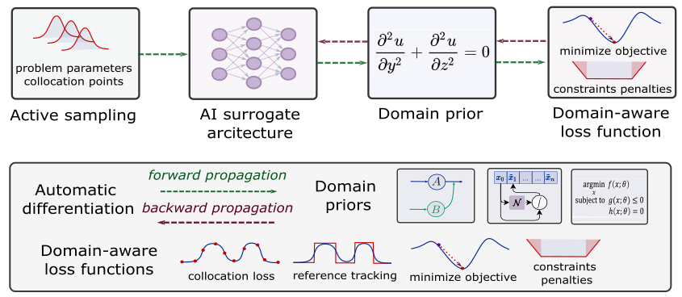
Components of Scientific Machine Learning
Karniadakis, G.E., Kevrekidis, I.G., Lu, L. et al. Physics-informed machine learning. Nat Rev Phys 3, 2021.
Thiyagalingam, J., Shankar, M., Fox, G. et al. Scientific machine learning benchmarks. Nature Reviews Physics 4, 413–420, 2022.
Nghiem T., Drgona J., et al. Physics-Informed Machine Learning for Modeling and Control of Dynamical Systems, ACC, 2023.

Slide 13

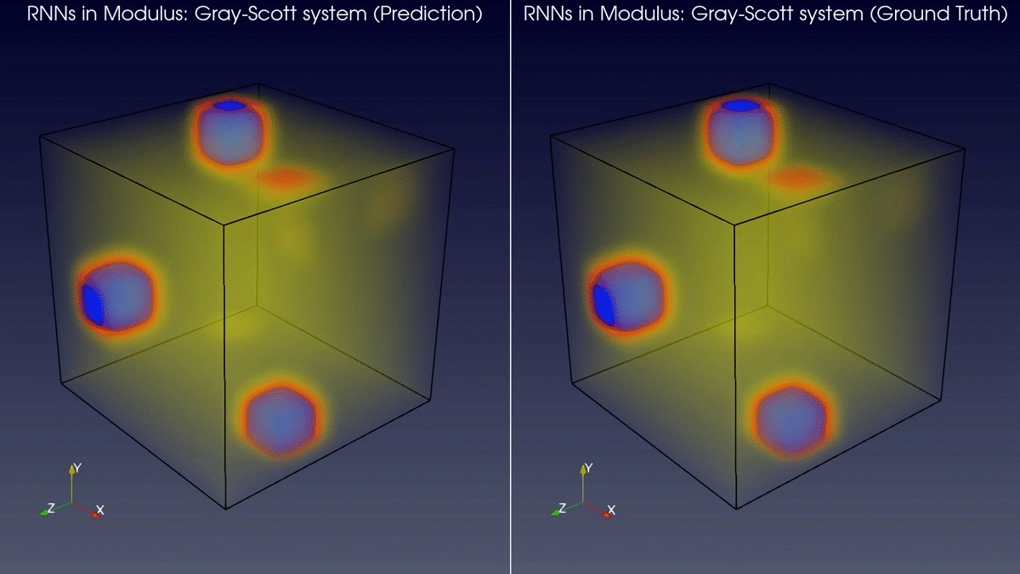
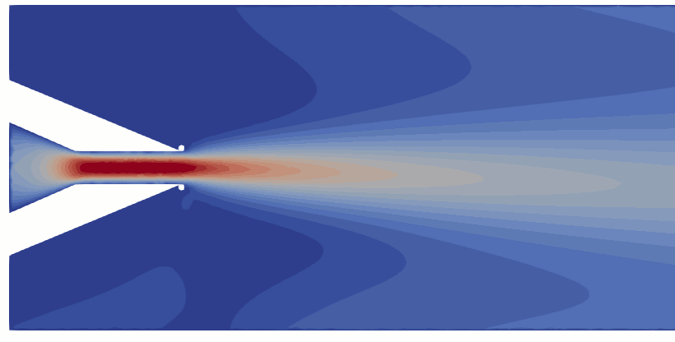
Learning to Solve Differential Equations with Physics-Informed Neural Networks (PINNs)
Training neural networks as PDE solutions
Application: Parameter estimation from data
M. Raissi, et al., Physics-informed neural networks: A deep learning framework for solving forward and inverse problems involving nonlinear partial differential equations, Journal of Computational Physics, 2019
Images: NVIDIA Modulus

Slide 14
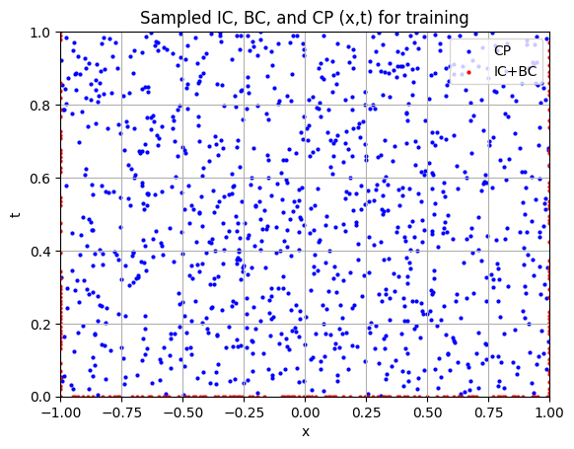
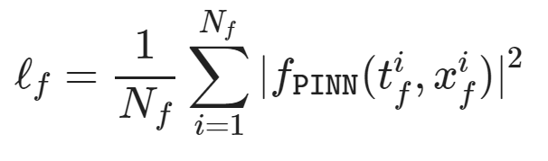
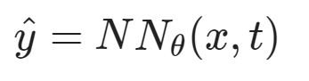
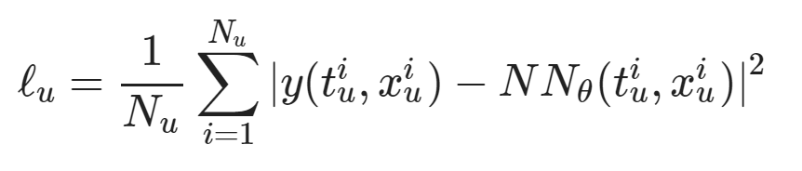
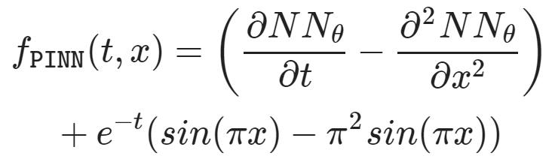
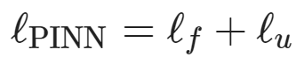
Learning to Solve Differential Equations with Physics-Informed Neural Networks (PINNs)
Dataset: collocation points in the spatio-temporal coordinates.
Architecture: PDE equations solved with neural network via automatic differentiation.
Loss function: minimizing PDE equation, initial and boundary condition residuals.
https://github.com/pnnl/neuromancer/blob/master/examples/PDEs/Part_2_PINN_BurgersEquation.ipynb
M. Raissi, et al., Physics-informed neural networks: A deep learning framework for solving forward and inverse problems involving nonlinear partial differential equations, Journal of Computational Physics, 2019

Slide 15
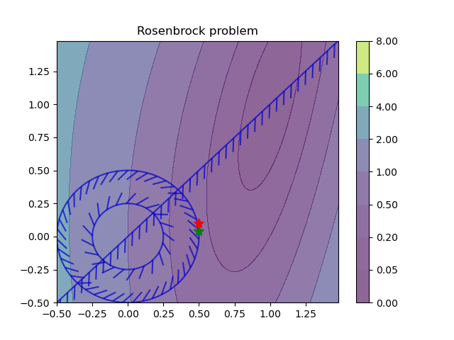
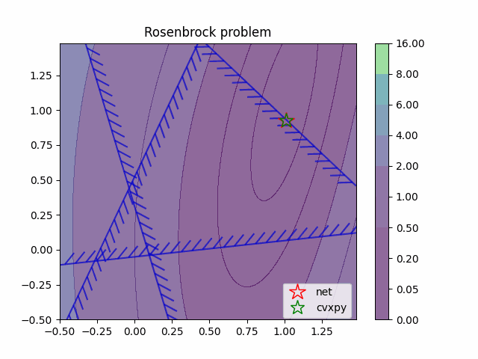
Learning to Optimize (L2O) with Constraints
Training neural networks as optimization solutions
Application: solving optimal power flow
James Kotary, et al., End-to-End Constrained Optimization Learning: A Survey, IJCAI, 2021

Slide 16
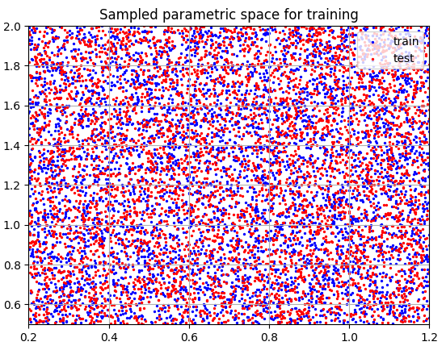
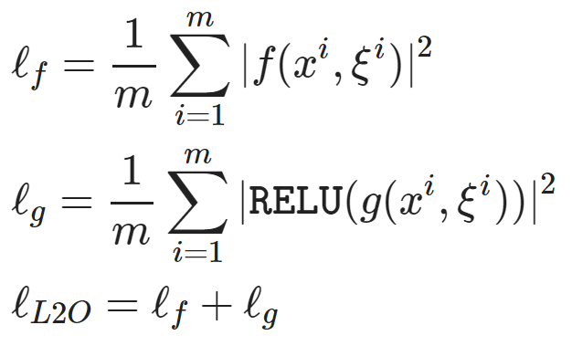
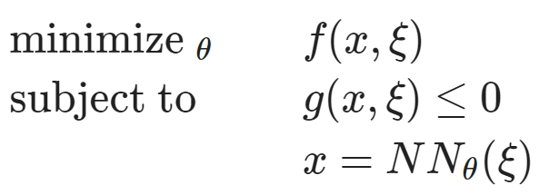
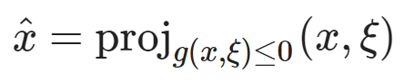
Learning to Optimize (L2O) with Constraints
Dataset: collocation points in the parametric space.
Architecture: differentiable optimization solver with neural network surrogate.
Loss function: minimizing objective function and constraints penalties.
https://github.com/pnnl/neuromancer/blob/master/examples/parametric_programming/Part_1_basics.ipynb
A. Agrawal, et al., Differentiable Convex Optimization Layers, 2019
P. Donti, et al., DC3: A learning method for optimization with hard constraints, 2021

Slide 17
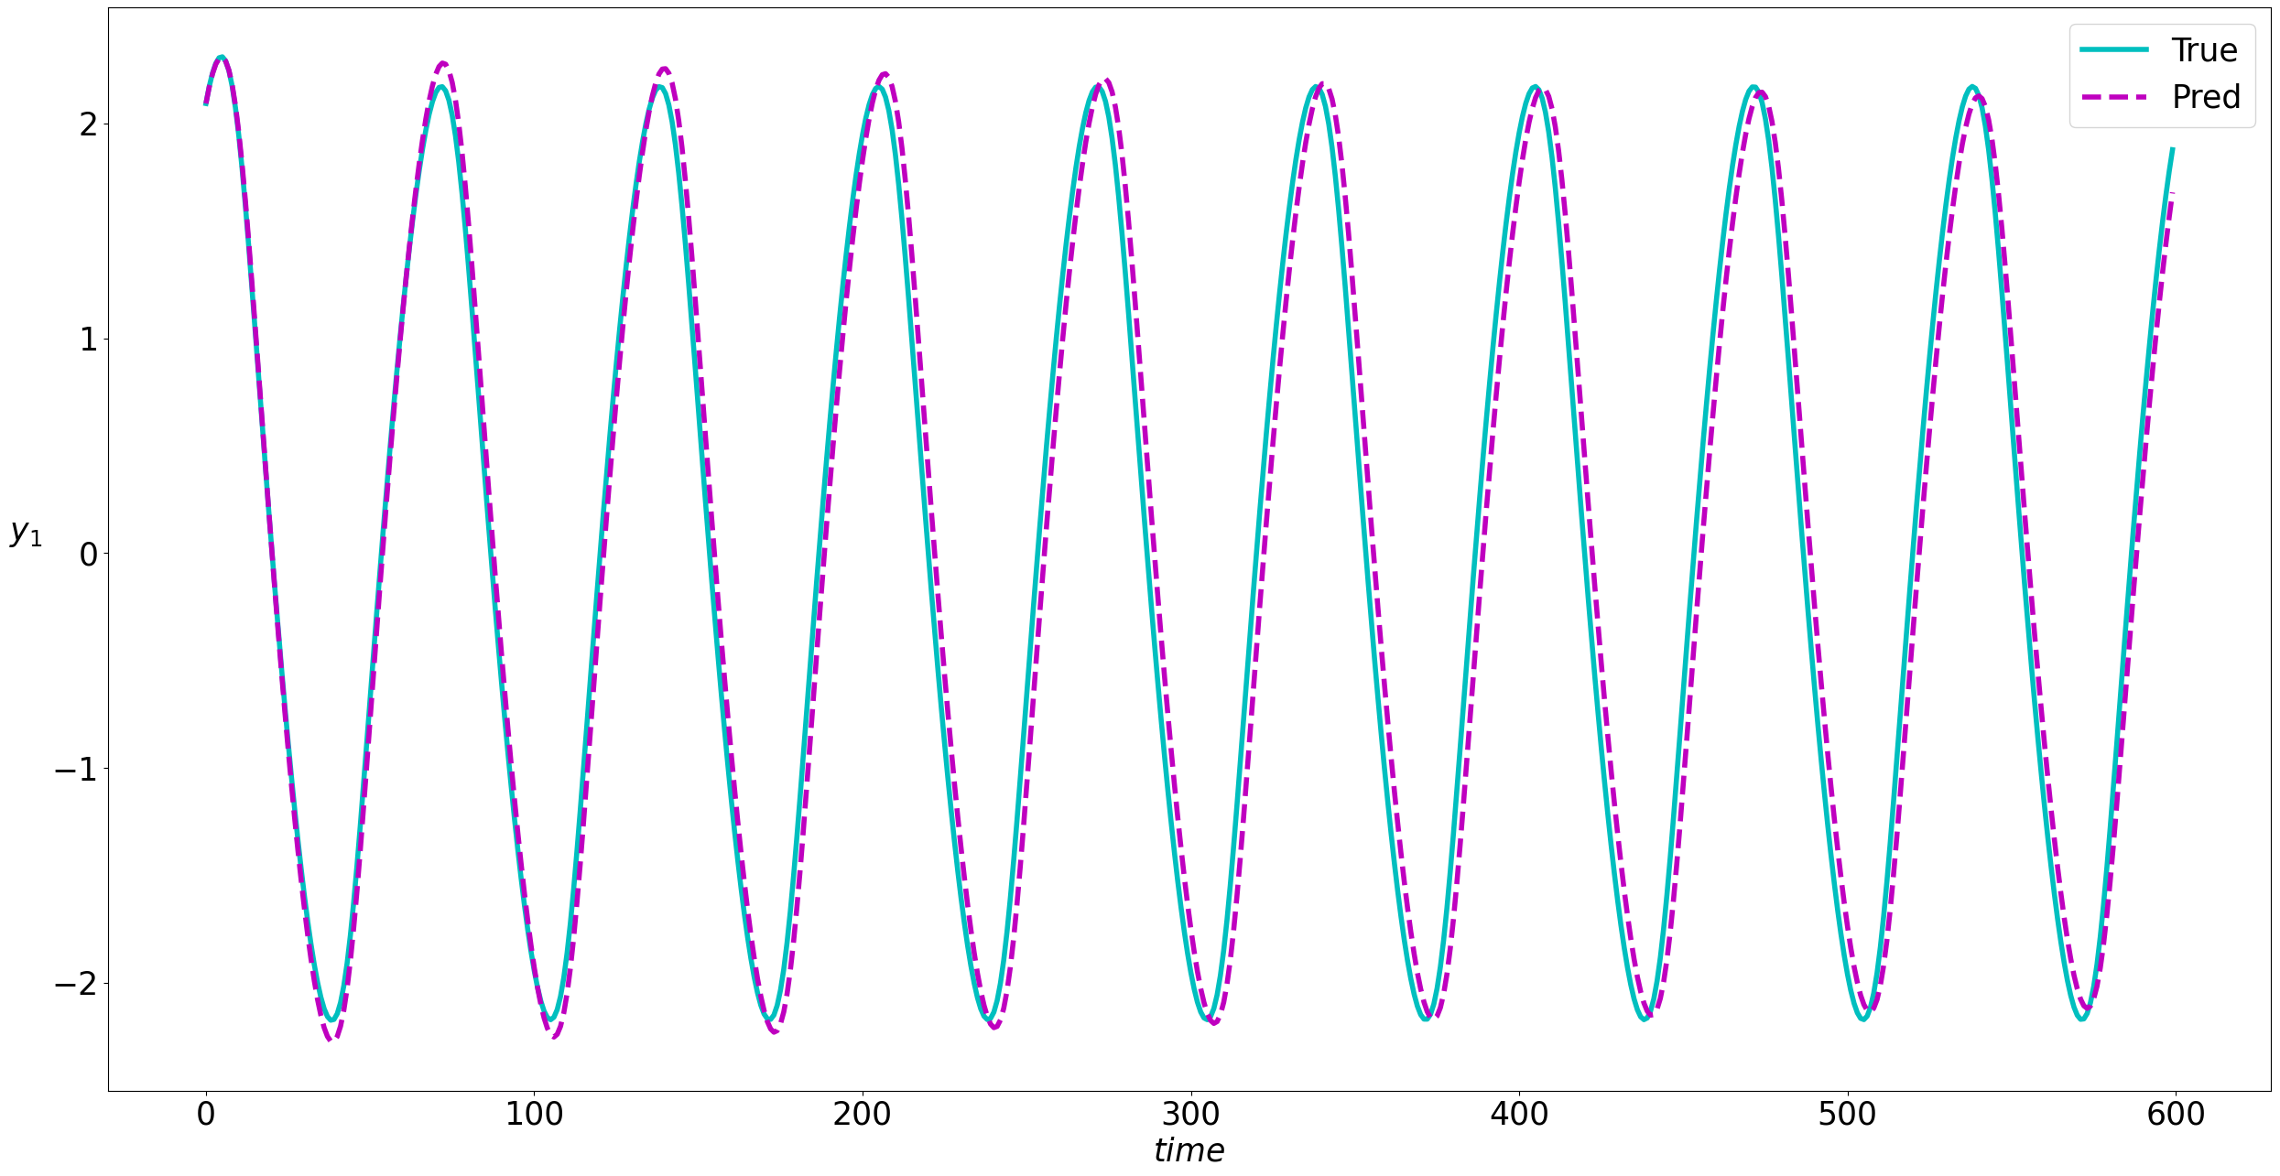
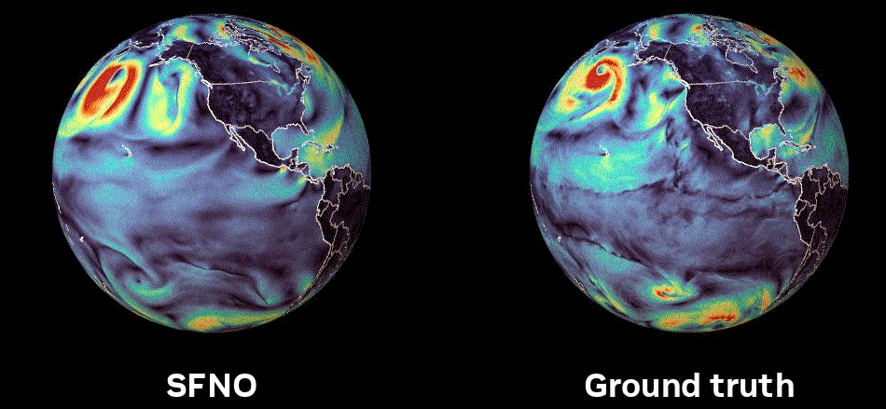
Learning to Model (L2M) Dynamical Systems
Neural models for nonlinear system identification
Application: climate modeling
R. T. Q. Chen, et al., Neural ordinary differential equations. NeurIPS, 2018
C. Rackauckas, et al., Universal Differential Equations for Scientific Machine Learning, 2021
Image: NVIDIA FourCastNet

Slide 18
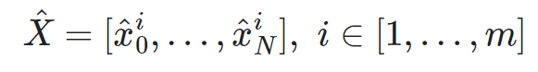
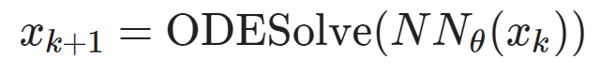
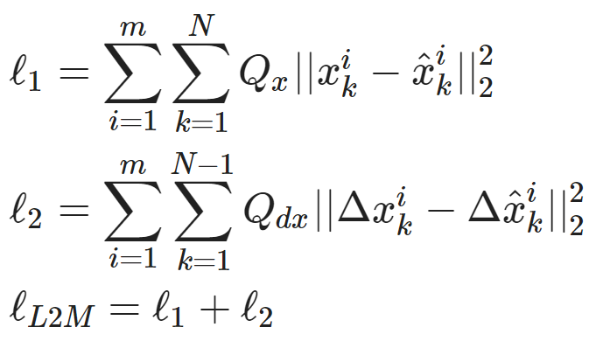
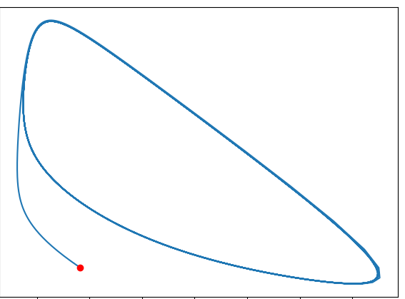
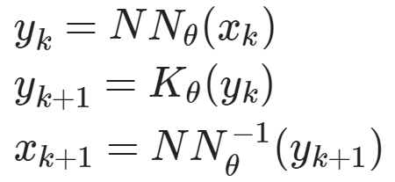
Learning to Model (L2M) Dynamical Systems
Dataset: time-series of states, inputs, and disturbances tuples.
Architecture: differentiable ODE solver with neural network model.
Loss function: trajectory matching, regularizations, and constraints penalties.
Architecture: Koopman operator with neural network basis functions.
https://github.com/pnnl/neuromancer/blob/master/examples/ODEs/Part_1_NODE.ipynb
R. T. Q. Chen, et al., Neural Ordinary Differential Equations, 2019
B. Lusch, et al., Deep learning for universal linear embeddings of nonlinear dynamics, 2018

Slide 19
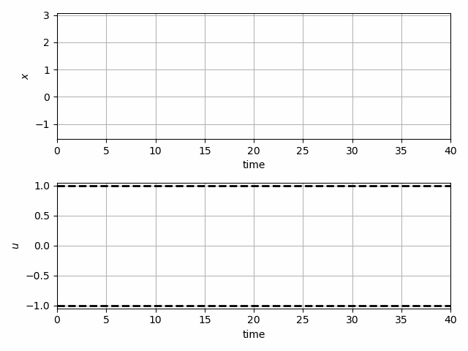
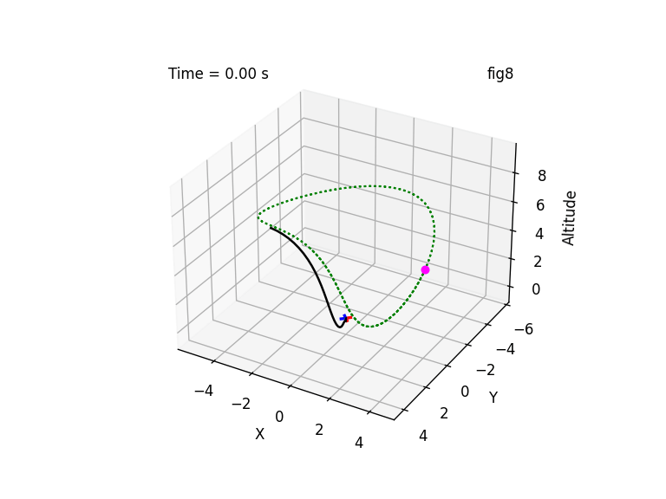
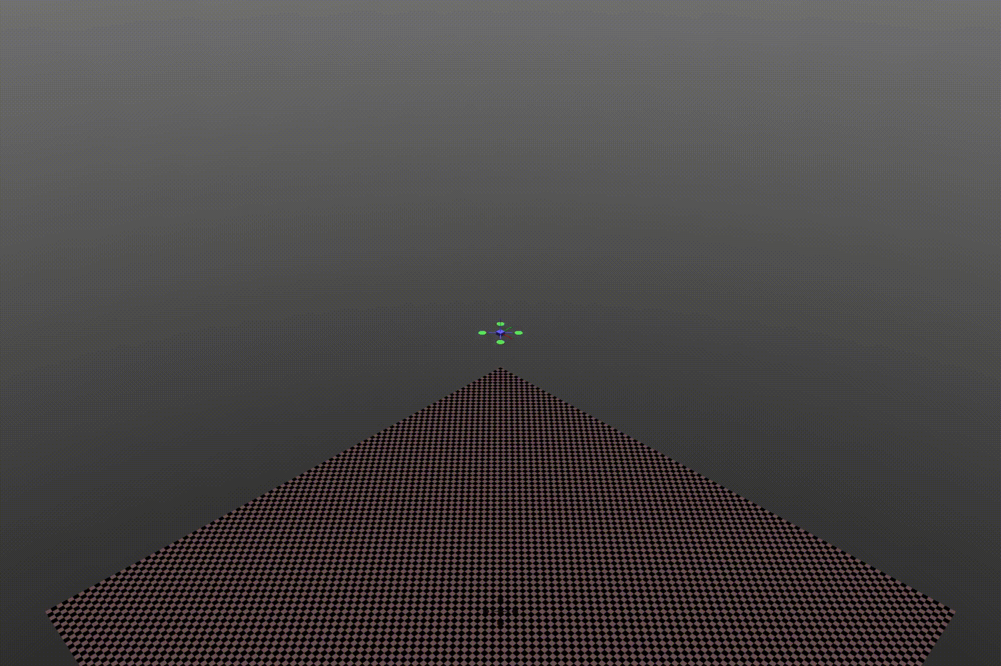
Learning to Control (L2C) via Differentiable Predictive Control (DPC)
Trajectory optimization for dynamical systems
Application: autonomous systems
J. Drgoňa, A. Tuor and D. Vrabie, "Learning Constrained Parametric Differentiable Predictive Control Policies With Guarantees," in IEEE Transactions on Systems, Man, and Cybernetics: Systems, 2024

Slide 20
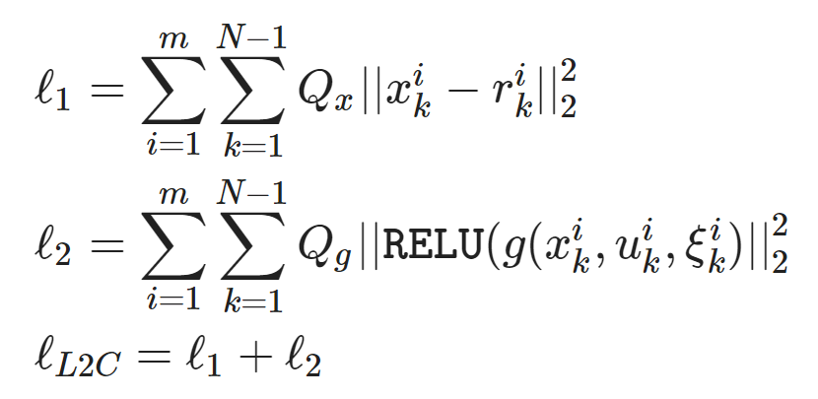
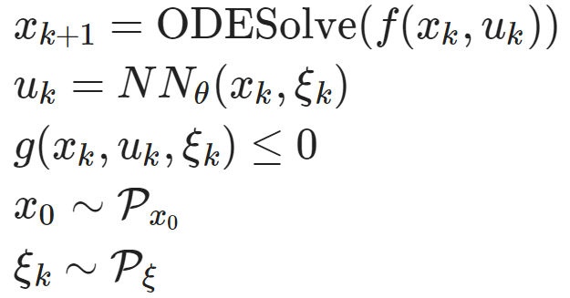
Learning to Control (L2C) via Differentiable Predictive Control (DPC)
Dataset: collocation points in the control parametric space.
Architecture: differentiable model with neural network control policy.
Loss function: reference tracking, constraints and terminal penalties.
https://github.com/pnnl/neuromancer/blob/master/examples/control/Part_3_ref_tracking_ODE.ipynb
Jan Drgona, et al., Differentiable Predictive Control: An MPC Alternative for Unknown Nonlinear Systems using Constrained Deep Learning, Journal of Process Control, 2022

Slide 21

NeuroMANCER Scientific Machine Learning Library
Open-source library in PyTorch
Physics-informed Neural Networks
Learning to optimize
Neural differential equations
Learning to control
github.com/pnnl/neuromancer

Slide 22
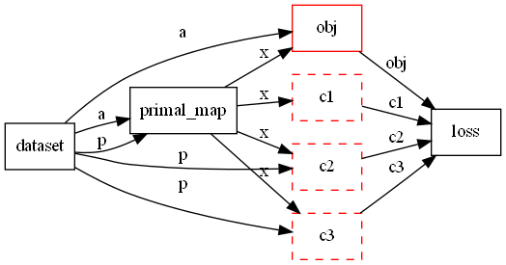
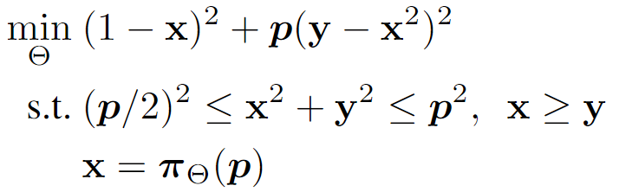
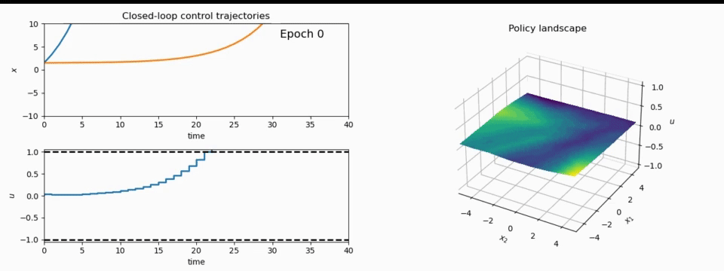
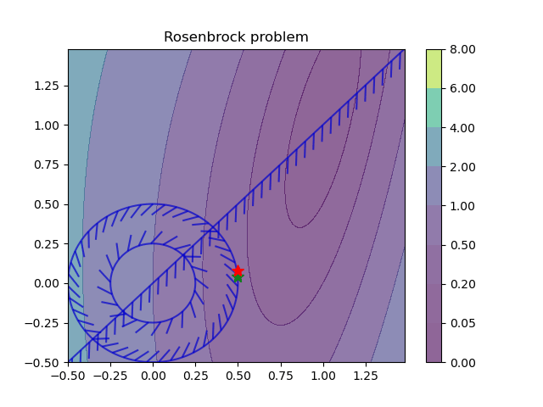
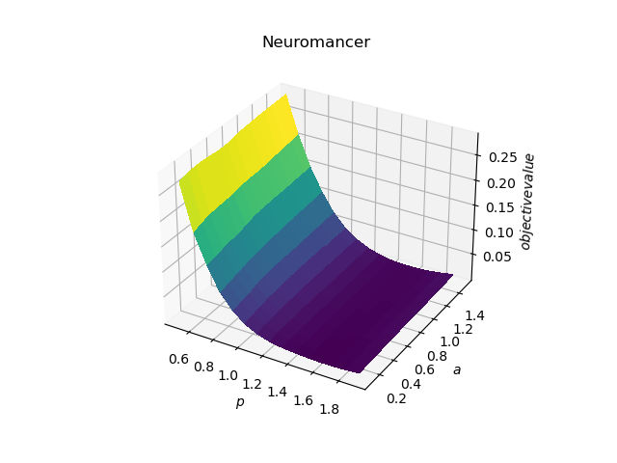
NeuroMANCER Scientific Machine Learning Library
1. Mathematical formulation
3. Problem graph
map
2. Python code interface
4. Results
import neuromancer as nm
p = nm.variable(‘p’)
x = nm.variable(‘x’)
y = nm.variable('y’)
obj = ((1-x)**2 + p*(y-x**2)**2).minimize(weight=1.0, name='obj’) c1 = (p/2)**2 <= x**2 + y**2
c2 = x**2 + y**2 <= p**2
c3 = x >= y net = nm.MLP(insize=2, outsize=2, hsizes=[80]*4) map = nm.Node(net, input_keys=['p’], output_keys=[‘x’,‘y’])
loss = nm.PenaltyLoss([obj], [c1, c2, c3]) problem = nm.Problem([map], loss)
optimizer = torch.optim.AdamW(problem.parameters()) trainer = nm.Trainer(problem,data,optimizer)
best_model = trainer.train()

Slide 23


Example Application: Building Energy Systems
Benefits of Scientific Machine Learning
Modeling and optimal control design is roughly 10-times faster and requires less expertise.
Real-time decisions are made orders of magnitude faster than traditional model-based approaches.
J. Drgona, et al., Physics-constrained deep learning of multi-zone building thermal dynamics, Energy and Buildings, 2021
J. Drgona, et al., Deep Learning Explicit Differentiable Predictive Control Laws for Buildings, IFAC NMPC 2021

Slide 24
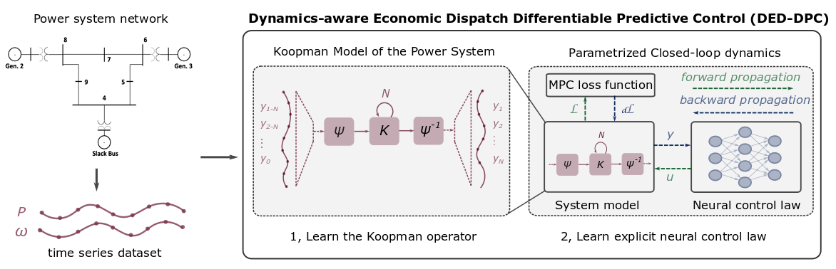
Example Application: Power Systems
Benefits of Scientific Machine Learning
Fast prototyping by re-using code template from building control project.
Real-time decisions are made orders of magnitude faster than traditional model-based approaches.
Ethan King, Jan Drgona, Aaron Tuor, Shrirang Abhyankar, Craig Bakker, Arnab Bhattacharya, Draguna Vrabie, Koopman-based Differentiable Predictive Control for the Dynamics-Aware Economic Dispatch Problem, American Control Conference 2022

Slide 25
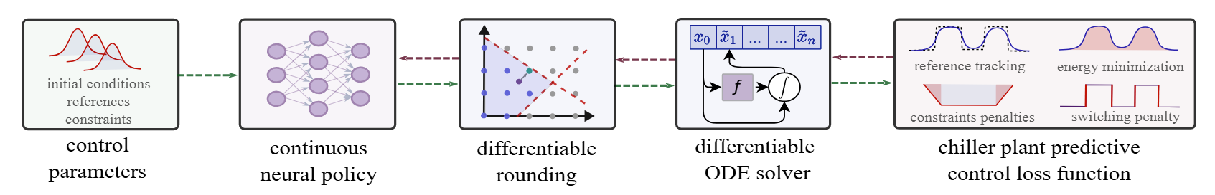
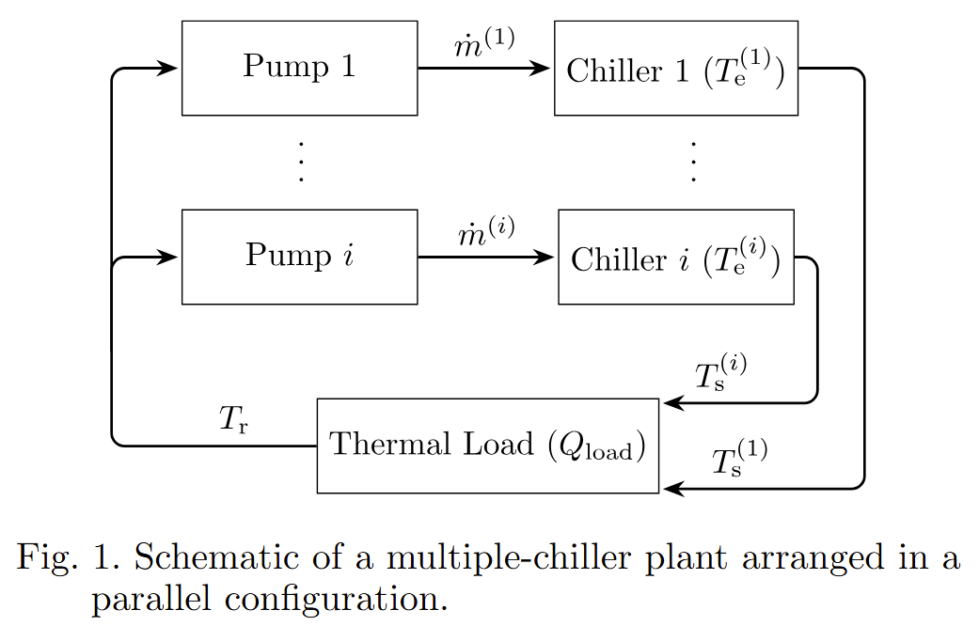
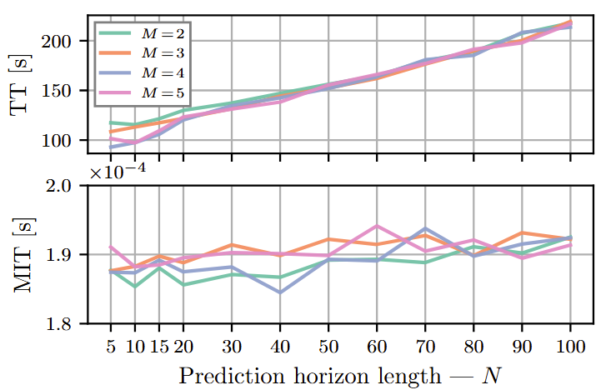
Example Application: Cooling of Data Centers
Benefits of Scientific Machine Learning
Computationally tractable solution of mixed-integer nonlinear optimal control problems.
Real-time decisions are made orders of magnitude faster than traditional model-based approaches.
Ján Boldocky, Cary Faulkner, Elad Michael, Martin Gulan, Aaron Tuor, Ján Drgoňa, Data Center Chiller Plant Optimization via Mixed-Integer Nonlinear Differentiable Predictive Control, under review, 2025

Slide 26
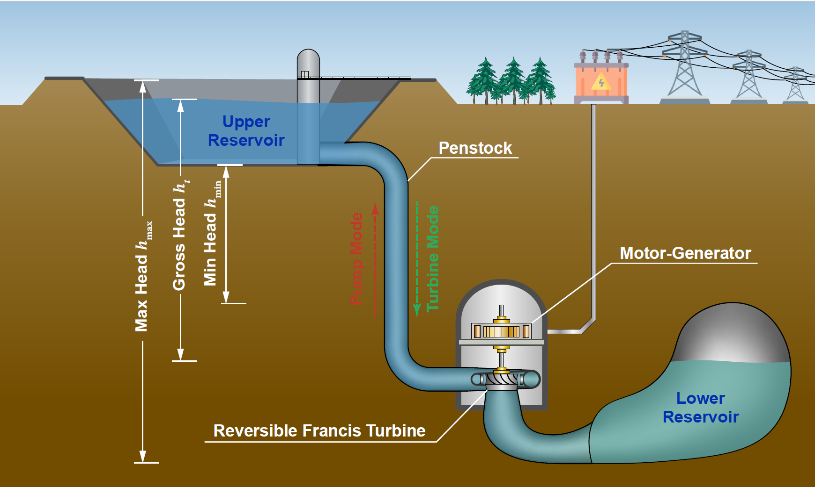

Example Application: Accelerating Underground Pumped Hydro Energy Storage Scheduling with Decision-Focused Learning
Benefits of Scientific Machine Learning
Addressing computational-accuracy trade-off in day-ahead scheduling.
300-fold speedup compared to mixed-integer quadratic programs with piecewise linear approximations.
Honghui Zheng, Pietro Favaro, Yury Dvorkin, Ján Drgoňa, Accelerating Underground Pumped Hydro Energy Storage Scheduling with Decision-Focused Learning, arXiv:2512.20880, 2025

Slide 27
Summary
Scientific machine learning (SciML) methods integrating deep learning, constrained optimization, physics-based modeling, and control
Learning to solve (L2S)
Learning to optimize (L2O)
Learning to model (L2M)
Learning to control (L2C)
Challenges
Mixed-integer decisions
Vanishing and exploding gradients
Offline pre-training vs online adaptation
Computational cost of uncertainty quantification and guarantees
Opportunities
Sampling efficiency via active sampling strategies
Control of high-dimensional PDEs
Applications in large-scale safety-critical systems
Development of new software tools

Slide 28
Week 12: Project Presentations and Evaluation
Projects cover 70% of the course grade!
Project proposal 20% - week 5
Project progress report 10% - week 8
Project final report 20% - week 11
Project presentation 20% - week 12
Project format.
Project technical report: 6 page long pdf document including references and figures.
Project presentation: ppt or pdf slides, 15 min time slot per student.
Admissible topics.
Application of selected SciML methods to problems inspired by real-world applications
e.g., L2O for large scale optimization of energy systems.
Development of new methods tackling some of the open challenges in SciML
e.g., novel way of utilizing PINNs in differentiable control for PDEs.
New theory supporting selected SciML methodology
e.g., convergence analysis of feasibility restoration layers in L2O.

